Slide 1
Predicting Revenue-Multiple Linear Regression

Slide 2
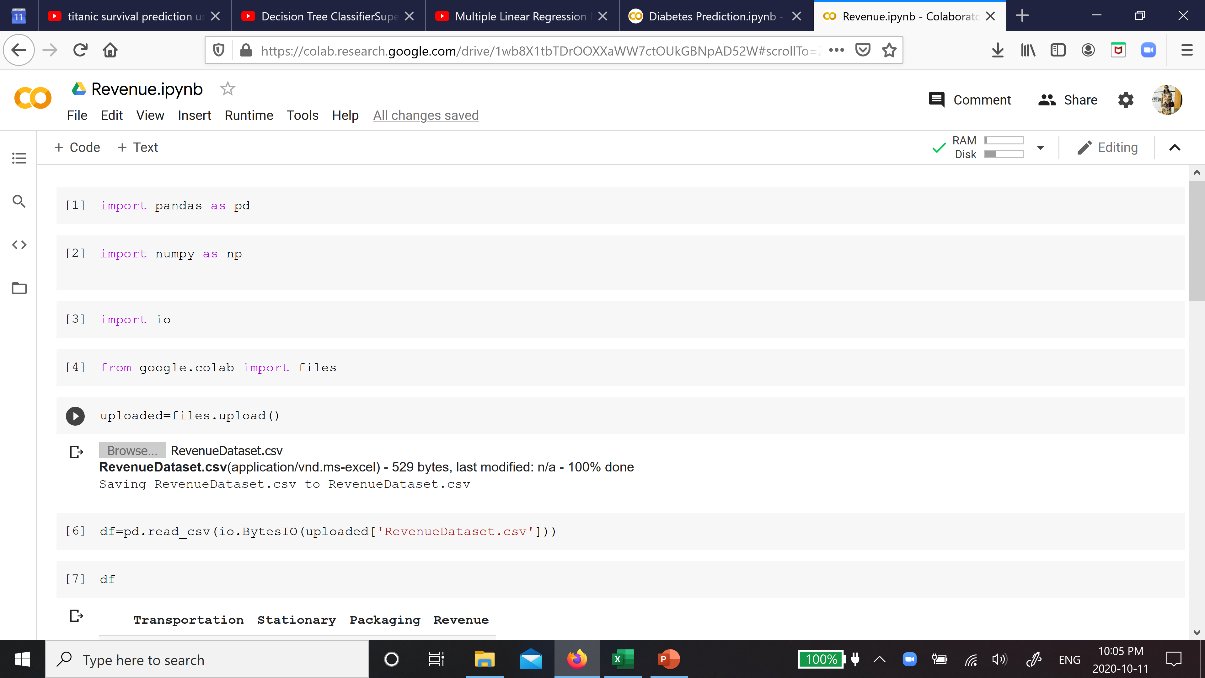
Importing libraries and loading dataset

Slide 3
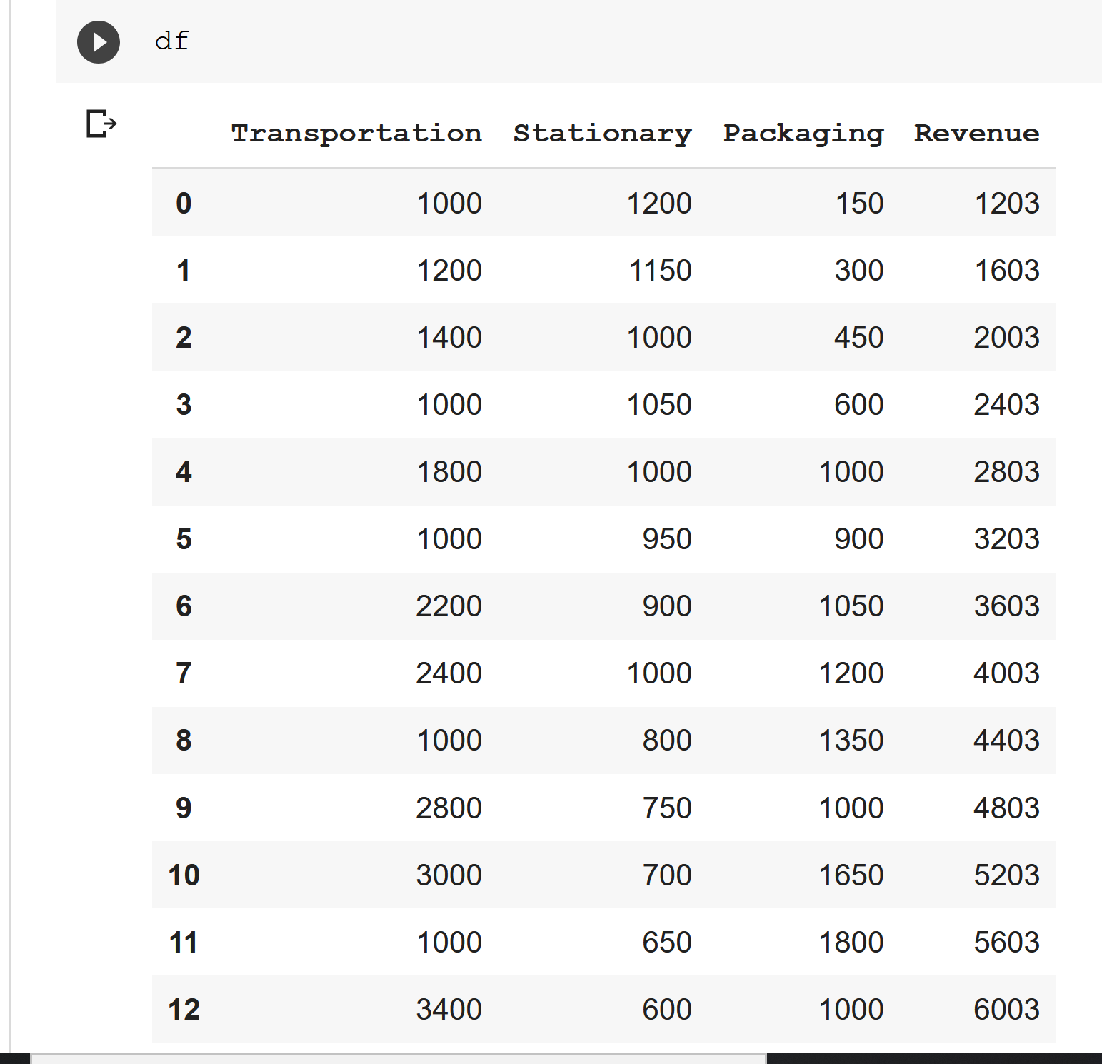

Slide 4
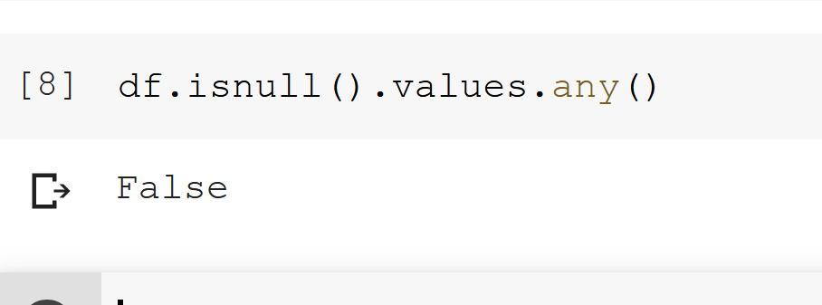
Check for null values

Slide 5
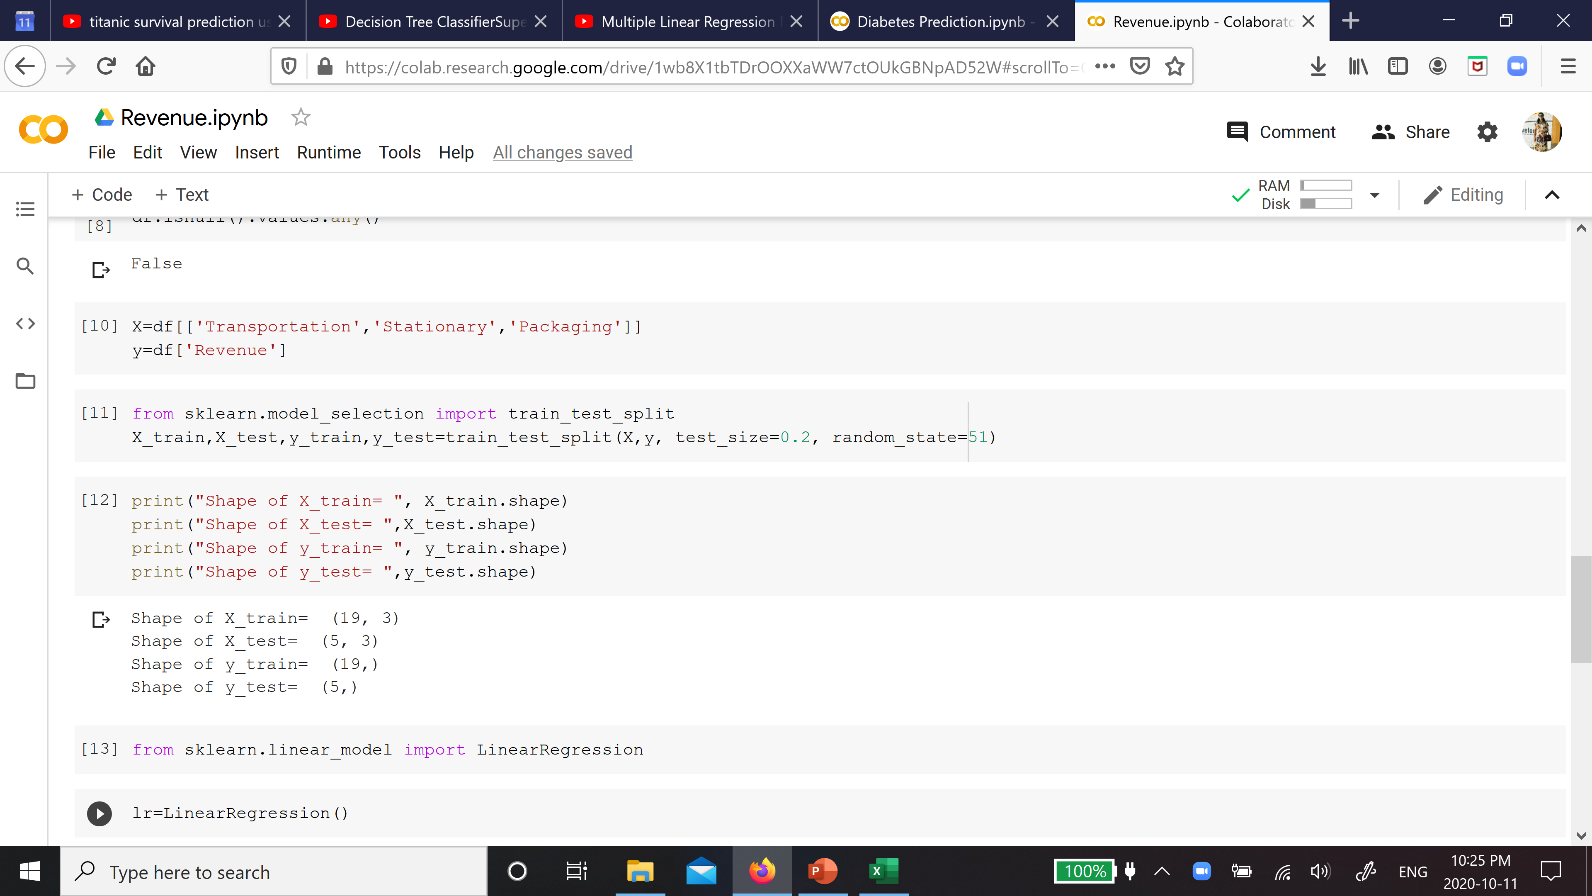
Take independent and dependent variable table, split into test and train data, apply linear regression

Slide 6
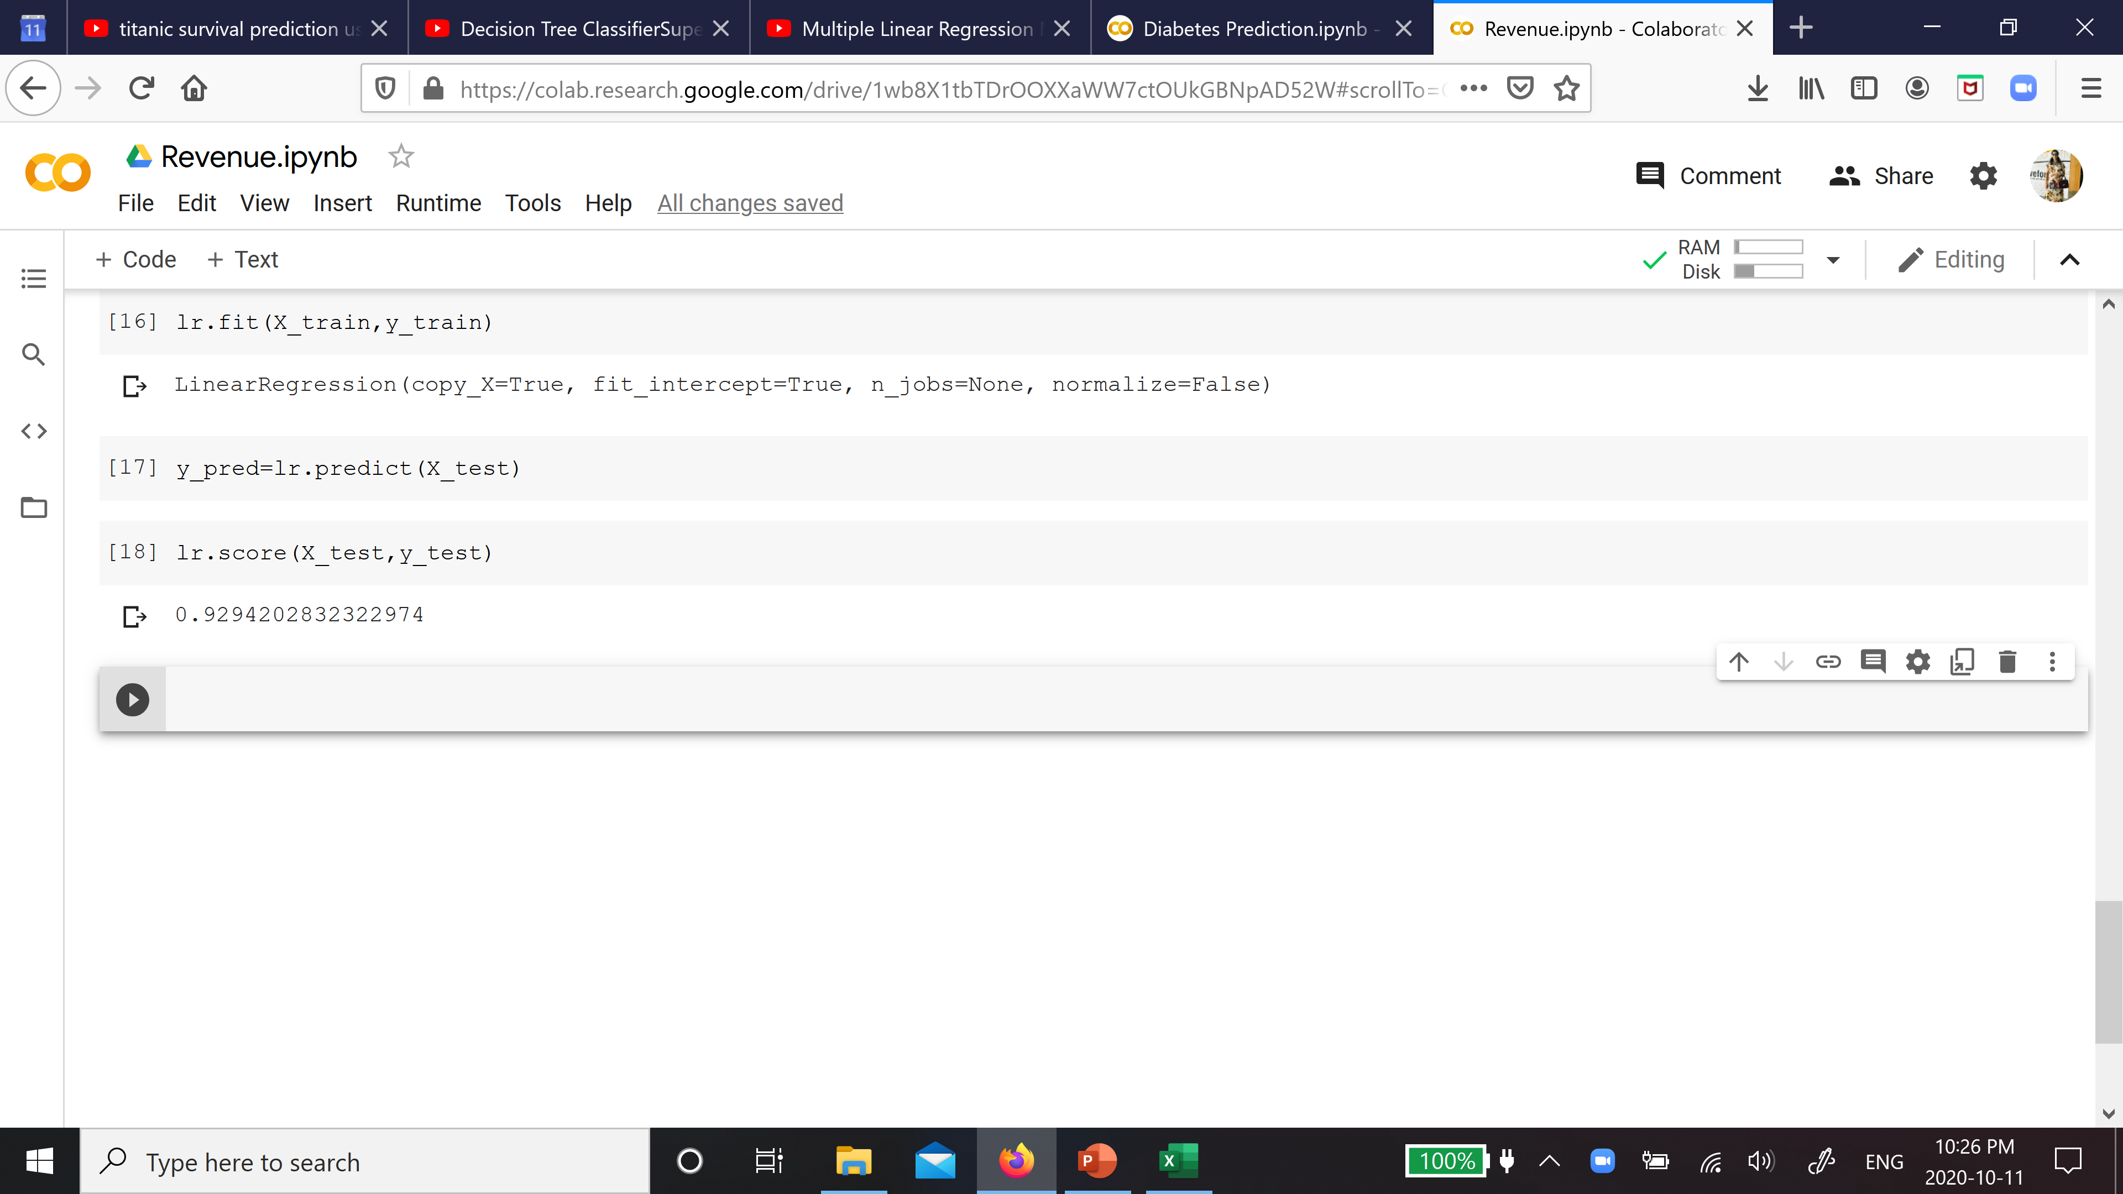
Fit the model, find predicted values, find score of the model

Slide 7
